Slide 1

Green University of Bangladesh
Department of Computer Science and Engineering (CSE)
Faculty of Sciences and Engineering
Spring 2024, B.Sc. in CSE (DAY)
Lab Report NO # 01
Course Title: Artificial Intelligence Lab
Course Code: CSE 316 Section: CSE 213 – D1
Problems / Tasks / Domains:
Student Details
Name | ID
Md. Shahidul Islam Prodhan | 213902017
Lab Date: Date
Submission Date: Date
Course Teacher’s Name: Fairuz Shaiara, Lecturer
[For Teacher’s use only: Don’t write anything inside this box]
Lab Report Status
Marks: | Signature:
Comments: | Date:

Slide 2
1. TITLE OF THE LAB REPORT EXPERIMENT
Creating a personalized routine and a login form using basic HTML, CSS.
2. OBJECTIVES/AIM
The primary objectives of this web programming lab are to demonstrate proficiency in creating and styling web pages using HTML and CSS. Specifically, the aim is to:
Develop a class routine page using HTML and CSS.
Design and implement a sign-in form page with proper styling.
3. PROCEDURE / ANALYSIS / DESIGN
Routine Page: Procedure: The routine page was constructed using HTML tables to organize the class schedule. CSS styles were applied to enhance the visual appeal, including background colors, text shadows, and linear gradients. The design utilized the colspan and rowspan attributes to merge cells and create a structured layout. Key points include: Use of HTML tables for organizing schedule data. CSS styles for background colors, text shadows, and linear gradients. Analysis: The analysis focused on the layout design, assessing usability, and readability. The color scheme and text shadows aimed to maintain clarity while adding a touch of sophistication. The linear gradient background contributed to an aesthetically pleasing representation of the class routine. Key points include: Emphasis on usability and readability. Balanced use of color and text shadows. Design: The HTML table structure was designed to present the routine information systematically. CSS styles were applied for a clean and professional appearance, ensuring responsiveness across different devices. Key points include: Responsive design principles. Cohesive color scheme and visually appealing design. | Sign-in Form Page: Procedure: The sign-in form page was implemented using basic HTML form elements and styled with CSS. The form utilized the text-shadow property and margin adjustments for enhanced visual appeal. Key points include: Utilization of HTML form elements. Application of CSS styles for alignment and formatting. Analysis: Attention was given to form element alignment, readability, and the application of text shadows for improved visibility. Key points include: Usability and accessibility considerations. Strategic use of text shadows for visibility. Design: The sign-in form was designed to be clean and professional. CSS styles were applied for alignment and formatting, with a focus on simplicity and user-friendliness. Key points include: Clean and professional design. User-friendly form interface.

Slide 3
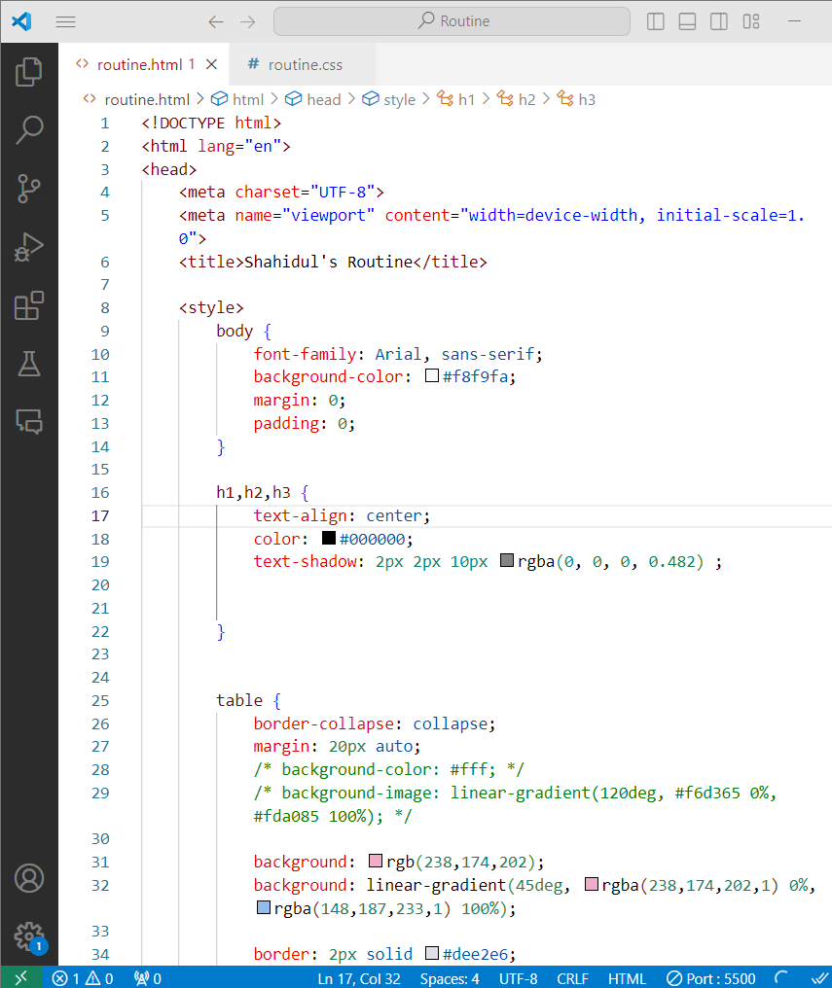
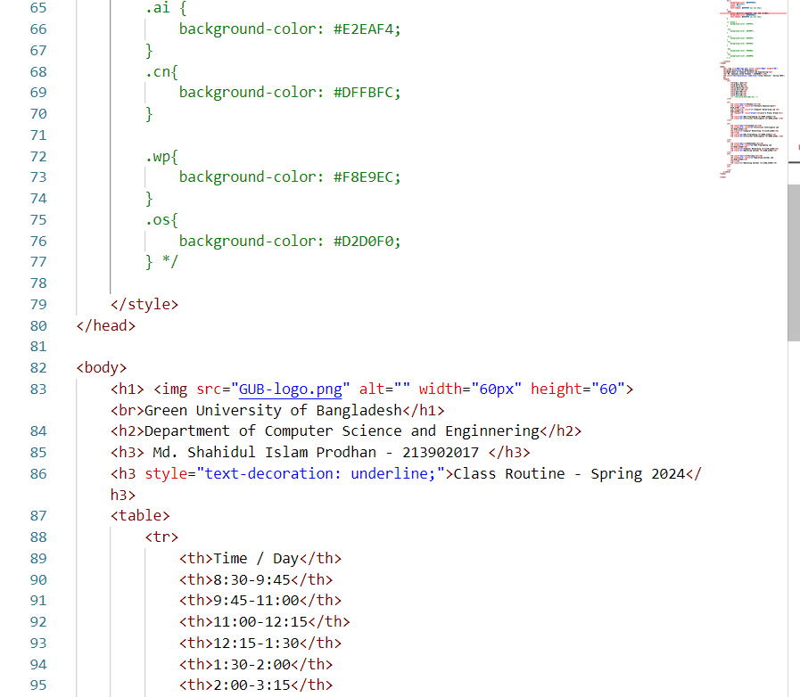
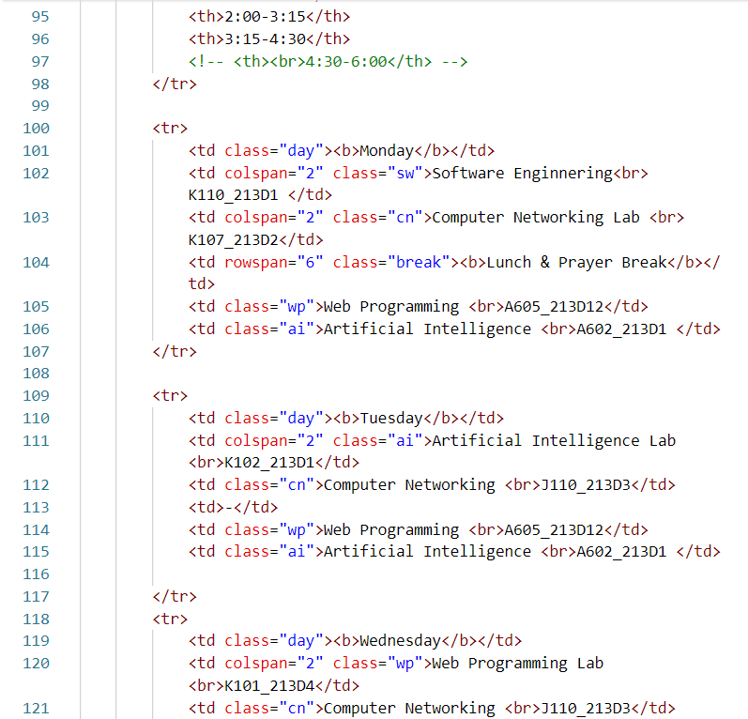
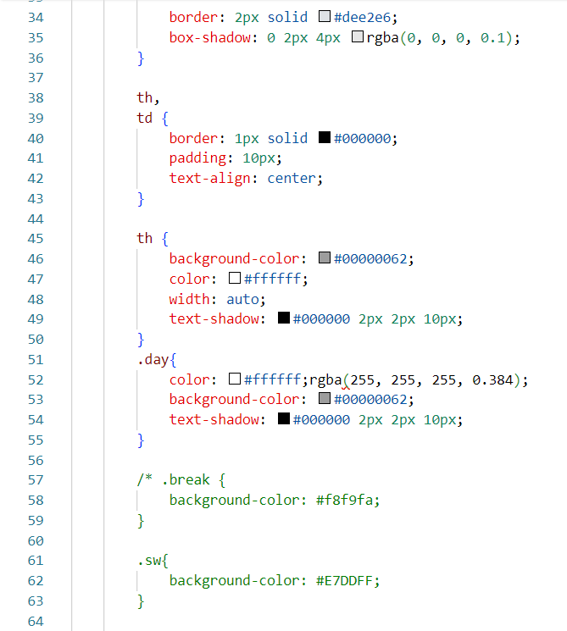
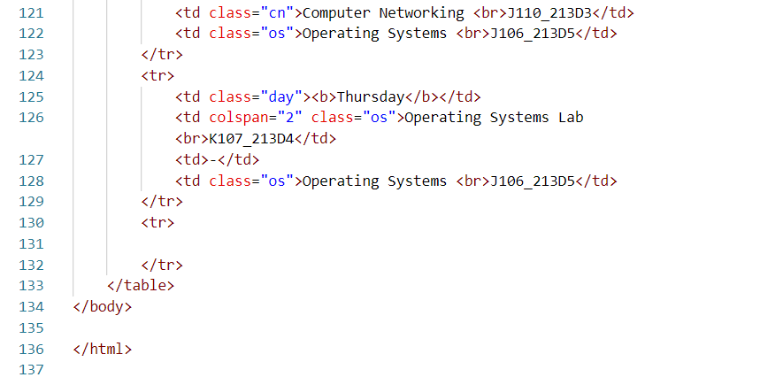
4. IMPLEMENTATION
Routine Page:

Slide 4
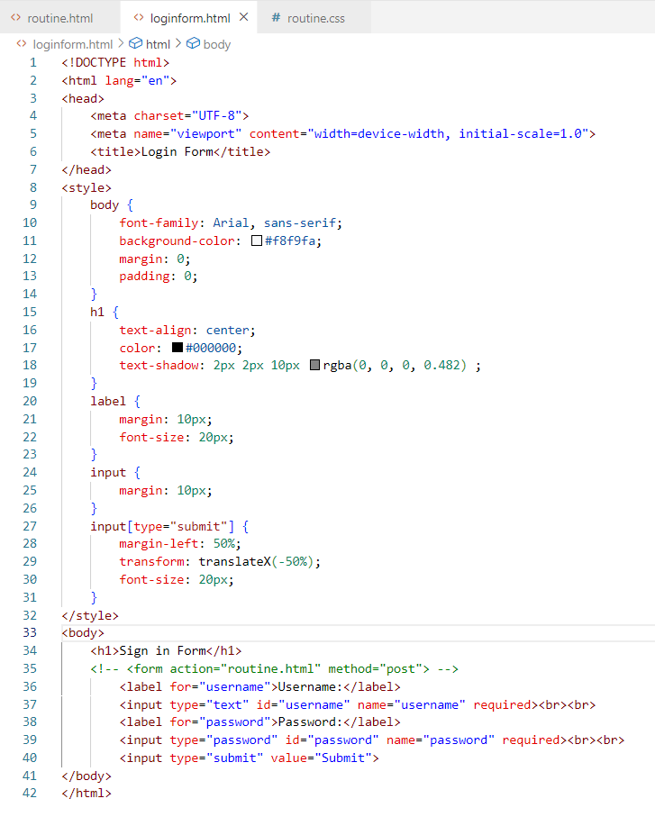
4. IMPLEMENTATION
Form Page:

Slide 5
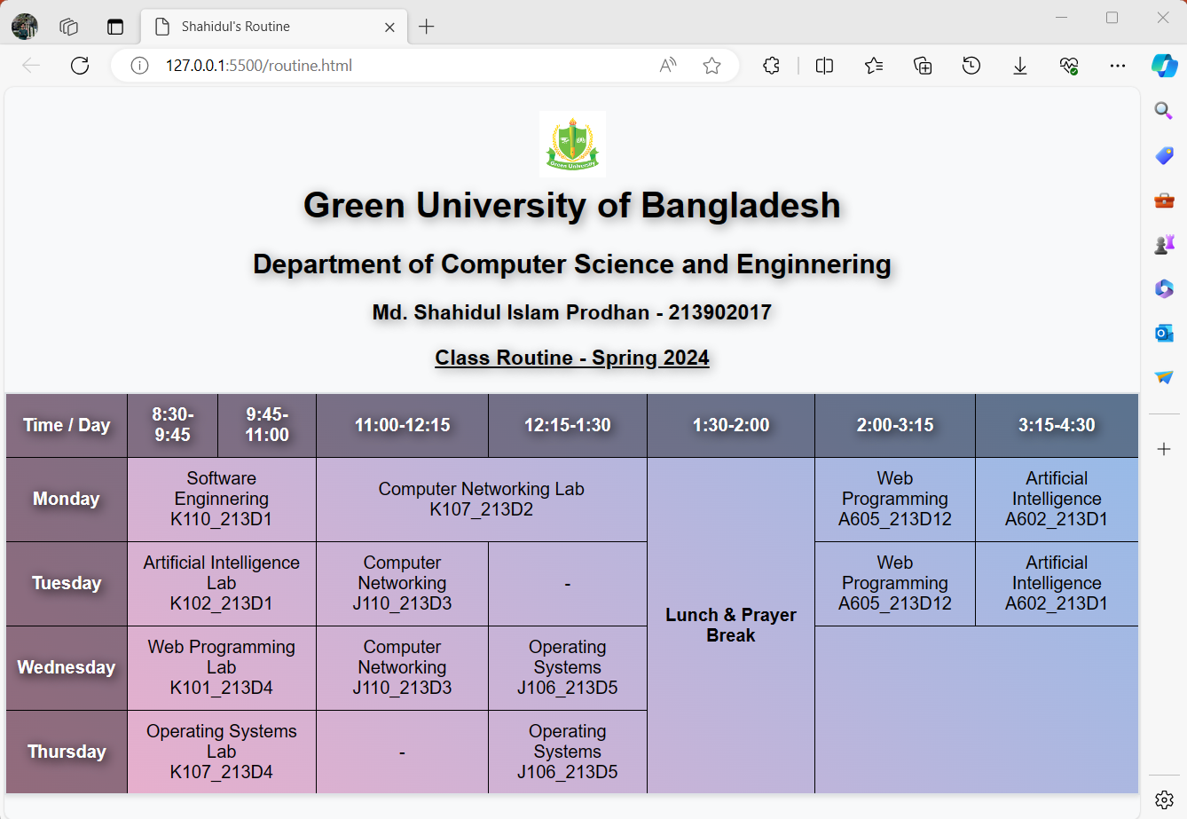
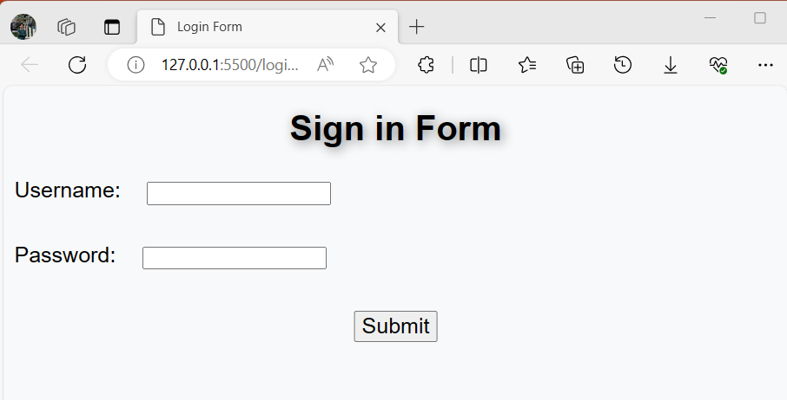
5. TEST RESULT / OUTPUT
Routine Page
Routine Page
Login / Sign in Form Page

Slide 6
6. ANALYSIS AND DISCUSSION
HTML Commands:
<html>, <head>, <meta>, <title>: Standard structure and metadata for the HTML document.
<body>: Main container for the content of the page.
<h1>, <h2>, <h3>: Heading tags for page titles and subtitles.
<table>, <tr>, <th>, <td>: HTML table elements for organizing class schedule data.
<form>: HTML form tag encapsulating form elements.
<input type="submit">: Submit button within the form.
HTML Attributes:
for, id, name: Attributes used to associate labels with form elements for accessibility and styling.
type: Specifies the type of input field, e.g., text or password.
required: Attribute used to make sure form fields are filled before submission.
colspan, rowspan: Attributes used in <td> and <th> to merge cells horizontally and vertically, enhancing layout structure.
id, class: Attributes used for specific styling and targeting with CSS.
CSS Classes:
.day: Class used to style the table cells containing the day names.
.sw, .cn, .wp, .ai, .os: Classes assigned to specific cells to categorize and style them based on the course type.
CSS Commands:
font-family: Used for setting the font style of the body text.
background-color: Applied to the body for a consistent background.
text-align: Used for centering the sign-in form title.
text-shadow: Applied for a subtle shadow effect on the title.
margin: Utilized for spacing and layout adjustments.
transform: Applied to the submit button for centering horizontally.
7. SUMMARY
In summary, the lab showcased the creation of a class routine page and a sign-in form page using HTML and CSS. Key takeaways include:
Successful utilization of HTML tables and form elements.
Strategic application of CSS styles for design and layout.
Positive test results, with minor user feedback considered for future enhancements.
Valuable hands-on experience in web programming and design principles.

